Slide 1
Computation
Chapter 4

Slide 2
Computational Issues
Goal of the book: be able to make useful claims about problems and the programs that solve them.
cast problems as language recognition tasks
define programs as state machines whose input is a string and output is Accept or Reject
Before examining the language classes outlines in chapter 3, we look at what we mean by computation:
• Decision procedures
• Nondeterminism
• Functions on functions and programs

Slide 3
Decision Procedures
An algorithm is a detailed procedure that accomplishes some clearly specified task.
A decision procedure is an algorithm to solve a decision problem.
Decision procedures are programs and must possess two correctness properties:
  must halt on all inputs
  when it halts and returns an answer, it must be the correct answer for the given input

Slide 4
Decidability
A decision problem is decidable (computable) iff there exists a decision procedure for it.
A decision problem is undecidable (noncomputable) iff there exists no a decision procedure for it.
A decision problem is semiecidable (semicomputable) iff there exists a semidecision procedure for it.
  a semidecision procedure is one that halts and returns True whenever True is the correct answer. When False is the answer, it may either halt and return False or it may loop.
Three kinds of problems:
  decidable (recursive)
  not decidable but semidecidable (recursively enumerable)
  not decidable and not even semidecidable

Slide 5
Decidable
Checking for even numbers: Is the integer x even?
Let / perform truncating integer division, then consider the following program:
even(x:integer)=
If(x/2)*2 = x then return True else return False
Is the program a decision procedure?

Slide 6
Undecidable but Semidecidable
Given an arbitrary Java program p that takes a string w as an input parameter. Does p halt on some particular value of w?
haltsOnw(p:program, w:string) =
1. simulate the execution of p on w.
2. if the simulation halts return True else return False.
Is the program a decision procedure?
Notes:
No. provable that the problem is not undecidable. But is semidecidable.

Slide 7
Not even Semidecidable
Given an arbitrary Java program p that takes a single string as input parameter. Does p halt on all possible input values?
haltsOnAll(p:program) =
1. for i = 1 to infinity do:
simulate the execution of p on all possible input strings of length i.
2. if all the simulations halt return True else return False.
Is the program a decision procedure? A semidecision procedure?
Notes:
By showing such a non-working procedure is not a proof

Slide 8
Nondeterminism
1. choose (action 1;;
action 2;;
…
action n )
2. choose(x from S: P(x))
choose is to find a successful value (any value other than False) if there is one, or return false, or fail to halt.
  do not care which successful value or how to find it
  a useful abstraction, separating design of the choose mechanism and design of the program
Programs include choose are nondeterministic
  Real computers are deterministic
a finite list of alternatives
each returns a successful value or False
Choose will return some successful value if there is one
or halt and return false when all actions halt and return false
or fail to halt when any path fails to halt
S maybe finite or infinite.

Slide 9
SAT Problem
A wff in Boolean logic is satisfiable iff it is true for at least one assignment of truth values to the literals it contains.
SAT: Given a Boolean wff w, decide whether or not w is satisfiable.

Slide 10
Nondeterministically Deciding SAT
decideSAT(w: Boolean wff) =
If there are no predicate symbols in w then:
Simplify w until it is either True or False.
Return w.
Else:
Find P, the first predicate symbol in w.
/* Let w/P/x mean the wff w with every instance of P
replaced by x.
Return choose (decideSAT(w/P/True);;
decideSAT(w/P/False)).

Slide 11
Implementing Nondeterminism: Search Tree
before the first choice choose makes
first call to choose first call to choose
choice 1 choice 2
second call to choose second call to choose
choice 1 choice 2

Slide 12
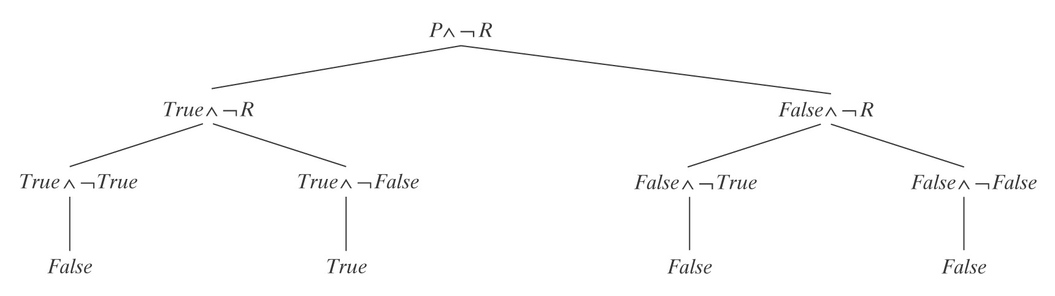
The SAT Example
In this case, decideSAT returns True.
It may do so after exploring all 4 paths, or it may guess correctly and find the successful path without considering any of the others …

